Slide 1
The Proton Computed Tomography Apparatus developed by INFN
M. Bruzzi^{1,2}, C. Civinini², G. Maccioni³, S. Pallotta^{2,4,5}, F. Paulis³, N. Randazzo⁶, M. Scaringella⁷, V. Sipala^{3,8}, C. Talamonti^{2,4,5}, E. Vanzi⁹
¹Physics and Astronomy Department, University of Florence, Florence, Italy
²INFN - Florence Division, Florence, Italy
³INFN Cagliari Division, Cagliari, Italy
⁴Department of Biomedical, Experimental and Clinical Sciences, University of Florence, Florence, Italy
⁵ SOD Fisica Medica, Azienda Ospedaliero-Universitaria Careggi, Firenze, Italy
⁶INFN - Catania Division, Catania, Italy
⁷Information Engineering Department, University of Florence, Florence, Italy
⁸Chemistry and Pharmacy Department, University of Sassari, Sassari, Italy
⁹ Fisica Sanitaria, Azienda Ospedaliero-Universitaria Senese, Siena, Italy
Advanced Semiconductor Detectors for Medical Applications
Garching 13/02/2015

Slide 2
Introduction
Two pCT systems: 5x5cm²; 5x20cm²
Results from the small area system
  Filtered Back Projection
  Algebraic Reconstruction Technique
Large area apparatus configuration
  Tracker (some considerations on MLP)
  Calorimeter
  Present status

Slide 3
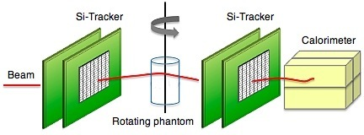
pCT apparatus
Single particle proton tracking: silicon strip detectors → MLP
Residual energy measurement: crystal calorimeter → energy loss
PARAMETER | VALUE
Proton beam kinetic energy | ~200 MeV
Proton beam rate | 1 MHz
Spatial resolution | < 1 mm
Electronic density resolution | <1%
Detector radiation hardness | >1000 Gy
Dose per scan | < 5 cGy
y
x
z
P₁
P₂
P₃
P₄
A set of single event information can be processed by appropriate reconstruction algorithms (ART, FBP) to produce tomographic images.

Slide 4
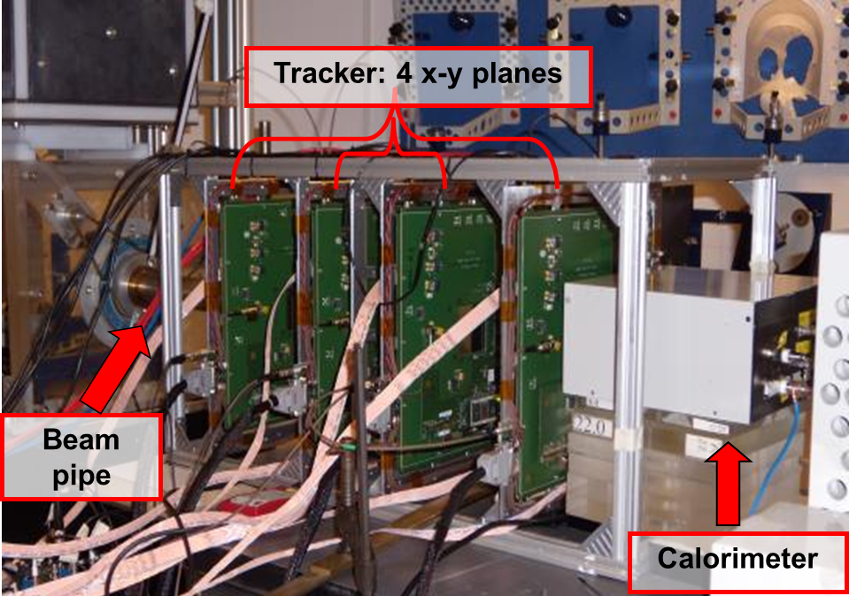
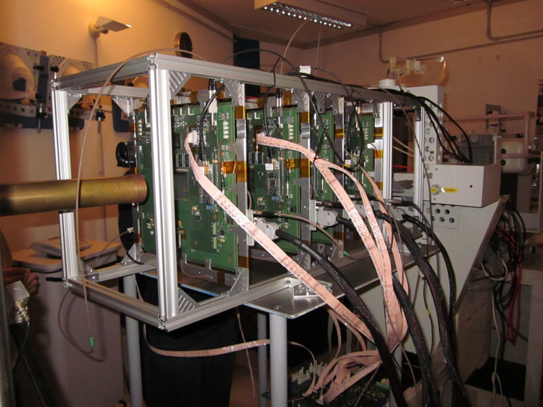
PRIMA collaboration: small area pCT apparatus
First test at INFN-LNS:
May 2011
CATANA beam line:
62 MeV protons
used to treat ocular tumors
Four x-y silicon microstrip based
tracking planes
Yag:Ce calorimeter
Proton entry and exit positions and directions
Proton residual energy

Slide 5
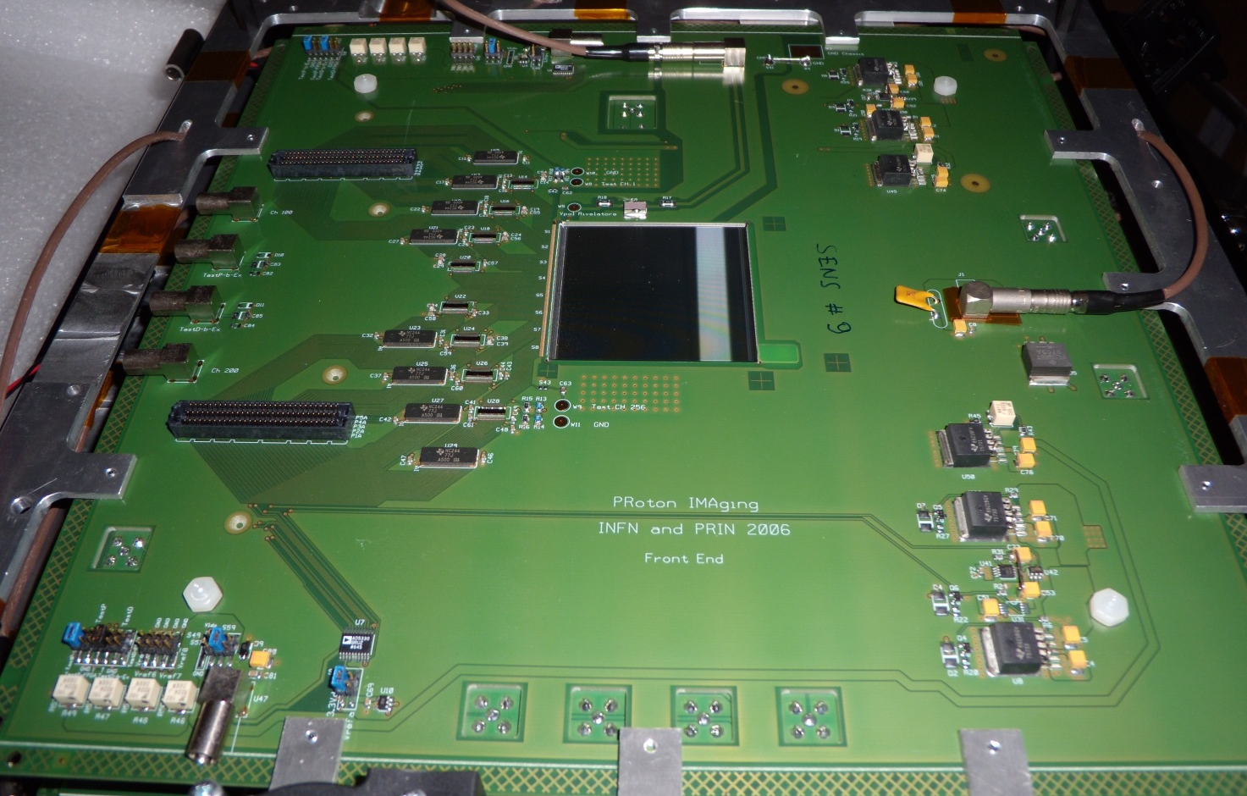
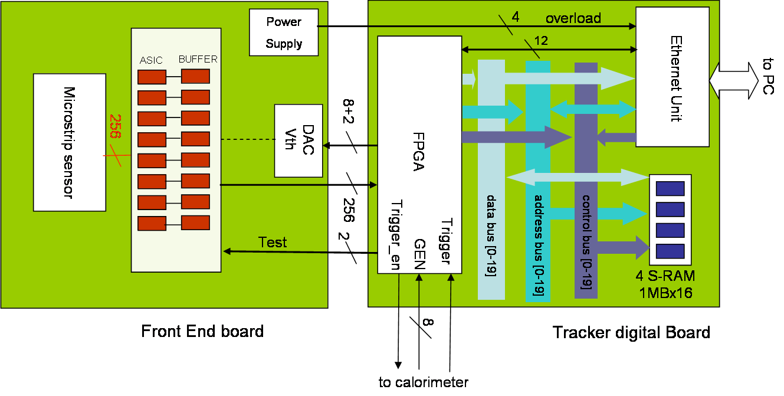
Tracker module
Digital board
Parallel strip read-out
Local data storing during measurement
Ethernet data download at measurement completion
Front-end board

Slide 6
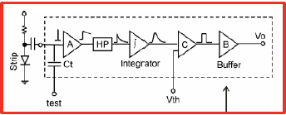
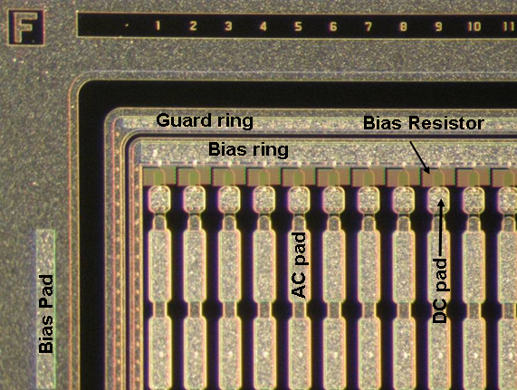
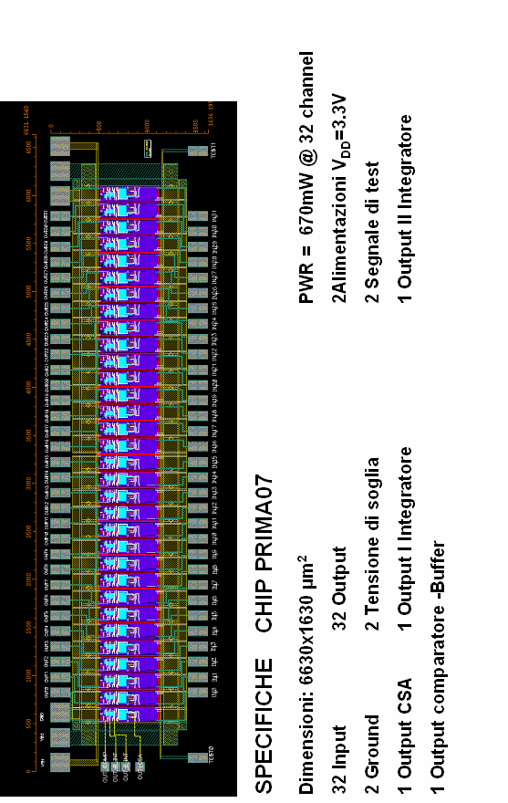
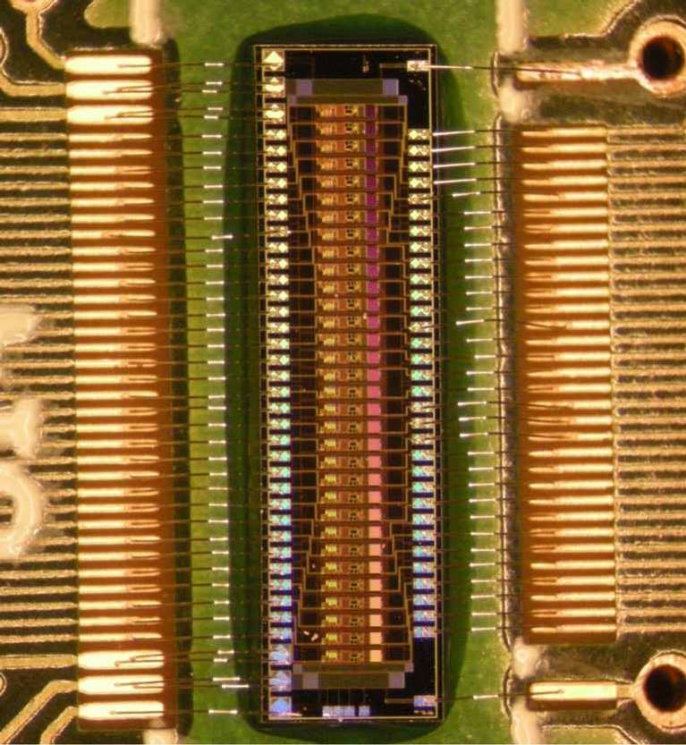
Si Sensor and Front-end ASIC
p on n
single sided
<100>
200μm thick
200μm strip pitch
6.6 x 1.6 mm²
32 inputs - 32 outputs
670 mW power consumption
Vcc=+3.3 V

Slide 7
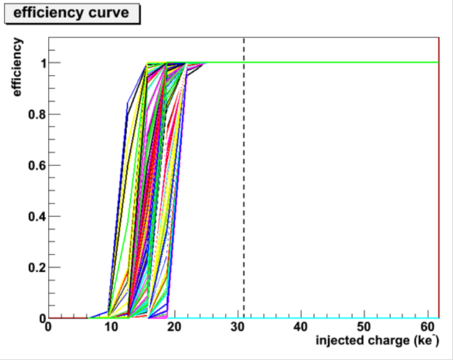
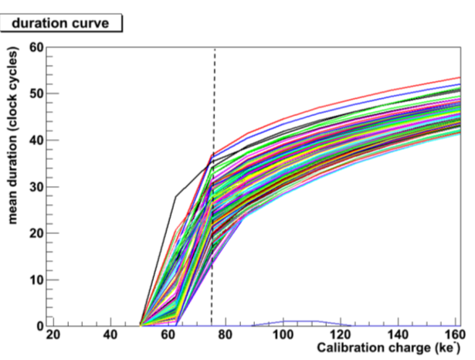
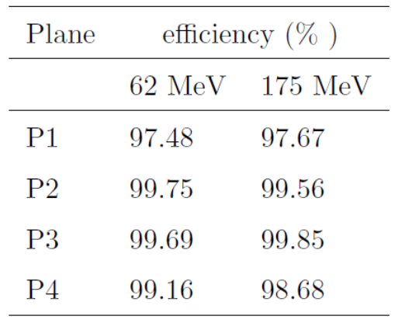
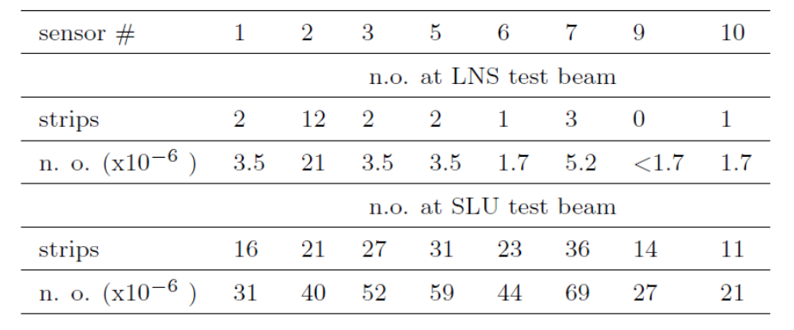
Tracker performance
62 MeV proton
minimum released charge
in 200μm of silicon
Signal duration
180 MeV proton
minimum released charge
in 200μm of silicon
Efficiency
Calibration
Noise occupancy per sensor
Data INFN-LNS +TSL (Uppsala)

Slide 8
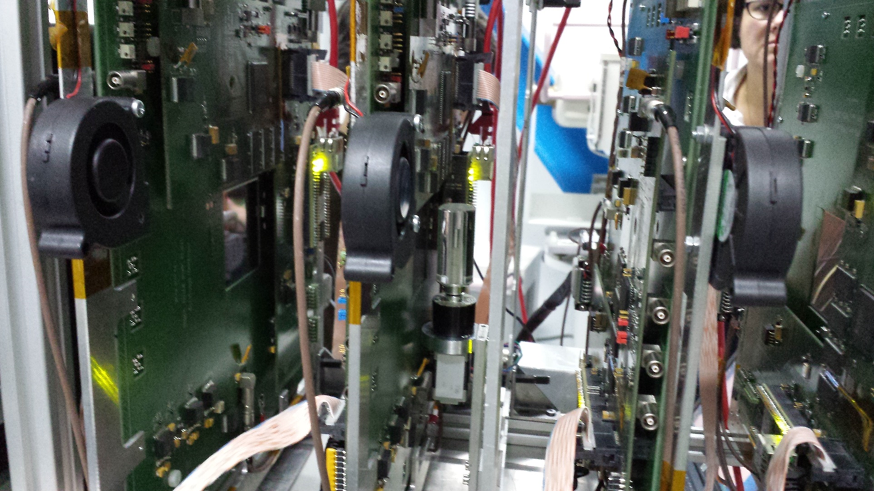
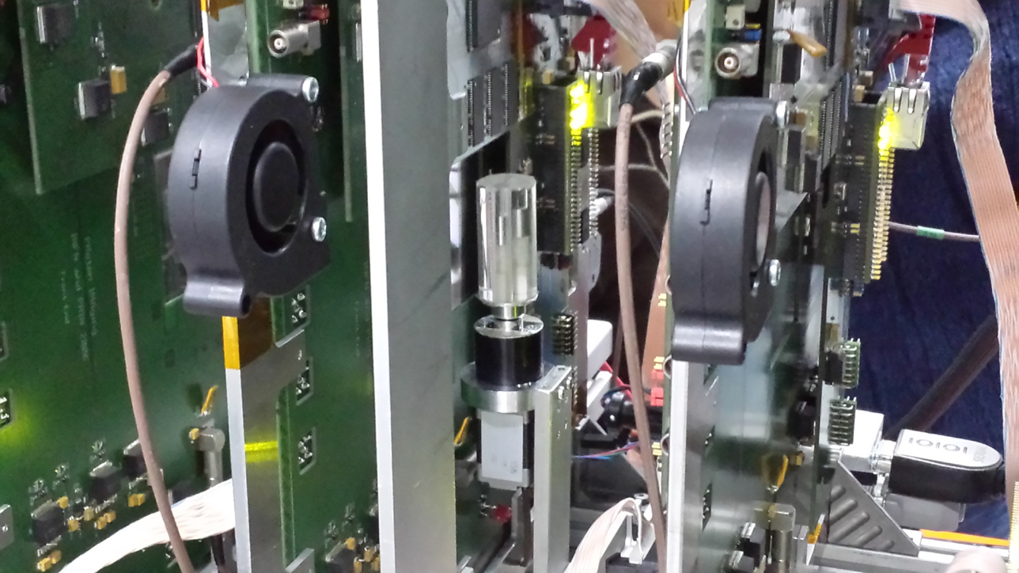
Tomografic set-up

Slide 9
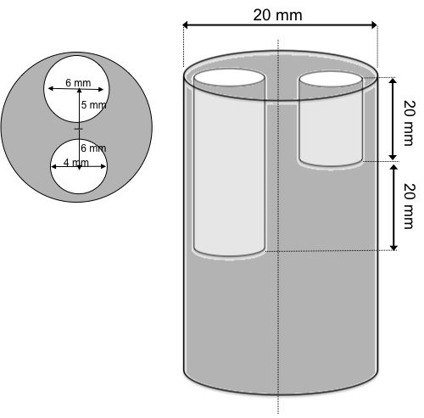
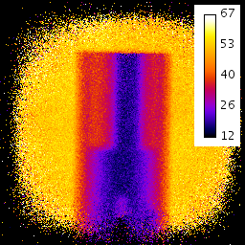
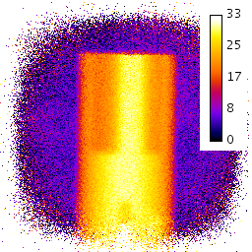
62 MeV pCT image - FBP
PMMA phantom
36 projection steps: 0° → 360°
An average of 950000 events per projection
E₀=62MeV INFN-LNS
Filtered Back Projection algorithm
Tomographic equation
(Wang, Med.Phys. 37(8), 2010: 4138)
Unknown stopping power distribution (at E₀)
«projection»
E_{res}
Wang projection
Evaluation of the “projection” term (through numerical integration starting from NIST tables and using the measured E_{res})

Slide 10
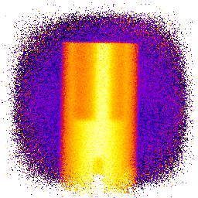

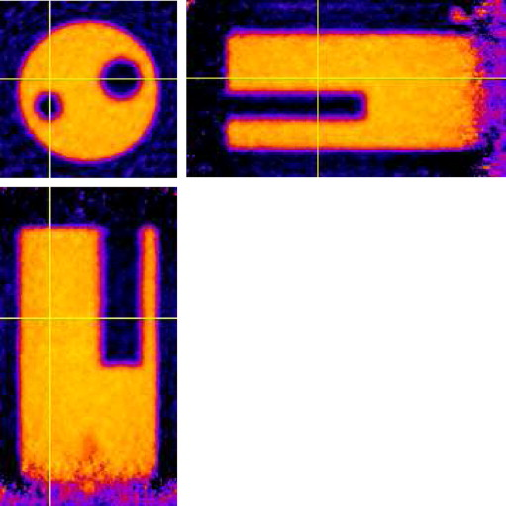
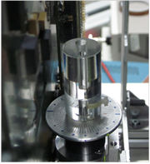
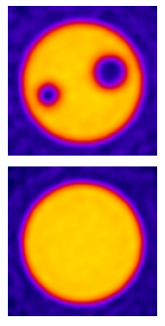
62 MeV pCT image - FBP
Butterworth filter: order 2,
cut-off 20/128 of the Nyquist freq.
No selection cuts has been applied to the data sample
noise: 2.4%
E. Vanzi et al. The PRIMA collaboration: preliminary results in FBP reconstruction of pCT data –RESMDD12 Conference doi:10.1016/j.nima.2013.05.193
noise: 6.3%

Slide 11
Algebraic Reconstruction Techniques
Iterative algorithm to reconstruct tomographic images from projections
Iterative formula:
x^{k+1}= x^{k} + λ_{k} {b_{i} - <a^{i},x^{k}> } a^{i} / ǁa^{i}ǁ²
Gordon, R; Bender, R; Herman, GT J. Theor. Biol. (1970) 29 (3): 471–81.
x^{k} image vector at iteration k (relative stopping power)
a^{i} i^{th} track length in each pixel → Tracker
b_{i} stopping power integral → Calorimeter
λ_{k} relaxing factor (constant value or →0 as ~k⁻¹)
x⁰ initial image: {0} or approx.

Slide 12
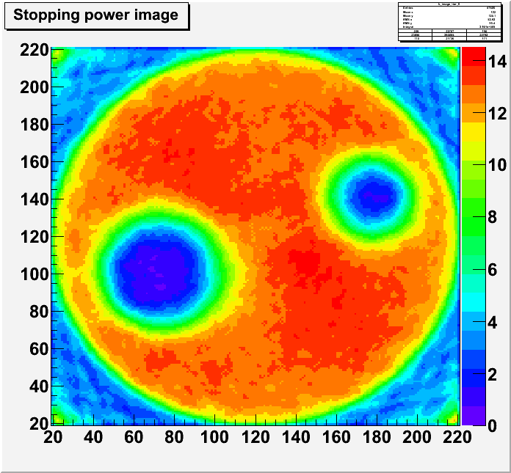
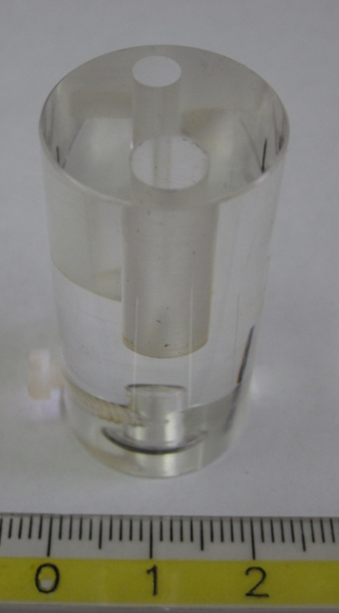
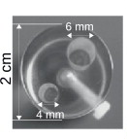
ART images from 62 MeV data
PMMA
phantom
x100μm
cm
ART reconstruction:
14 iteration starting from {0}
~ 10⁶ events per angle
(36 angles)
4mm vertical slice selected
(2D only)
~4’ per iteration CPU time
No MLP is used → to be done
1 cm
x100μm

Slide 13
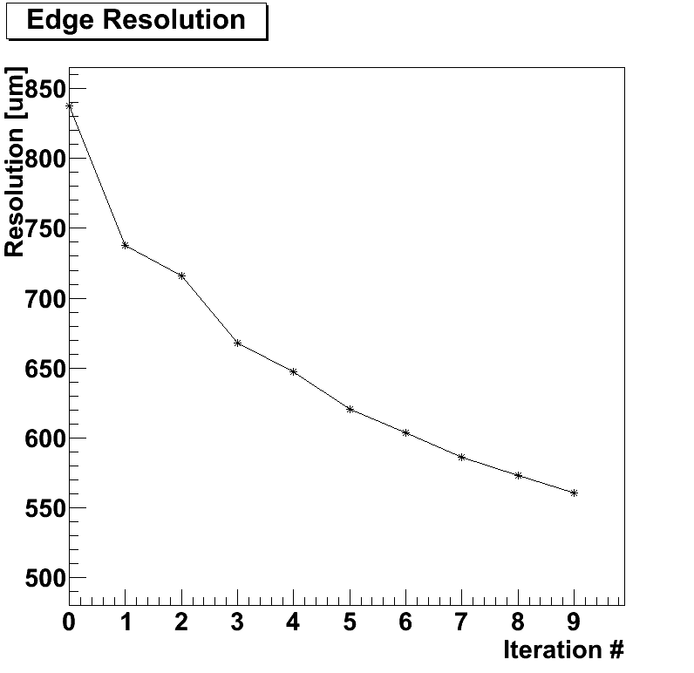
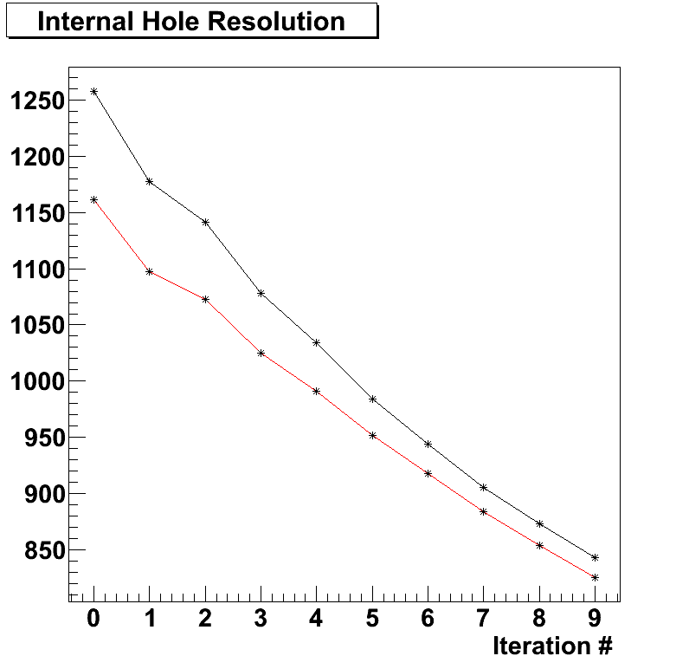
ART images from 62 MeV data
Resolution [μm]
Starting image = {0}, still room to improve

Slide 14
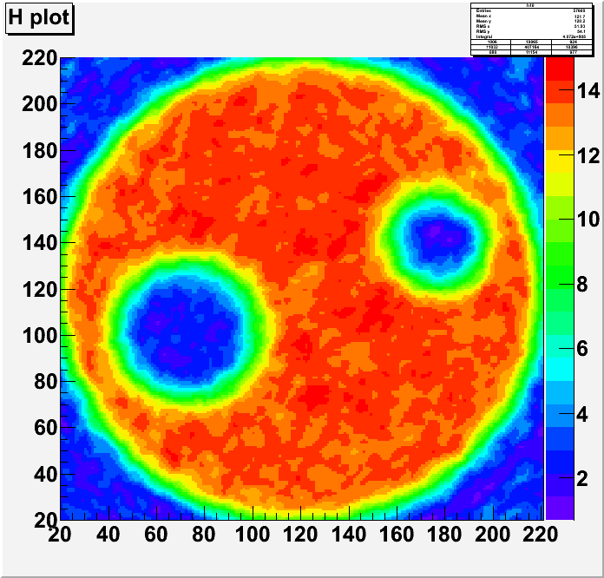
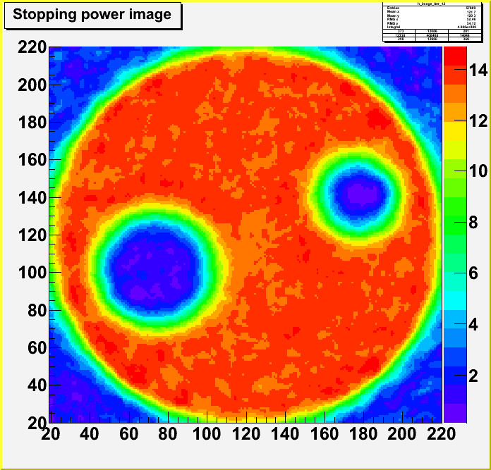
FBP used as seed for ART
x100μm
x100μm
x100μm
x100μm
FBP initial image →
ART after 14 iterations starting
from FBP seed

Slide 15
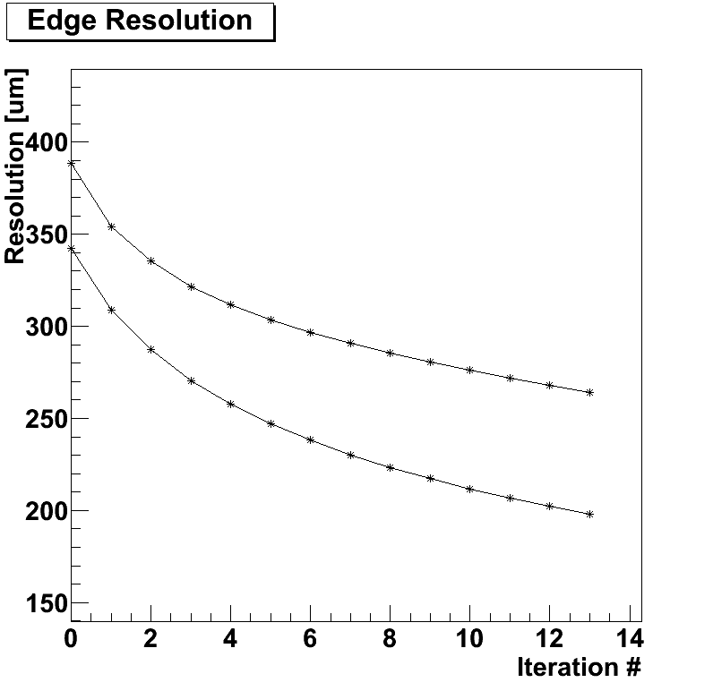
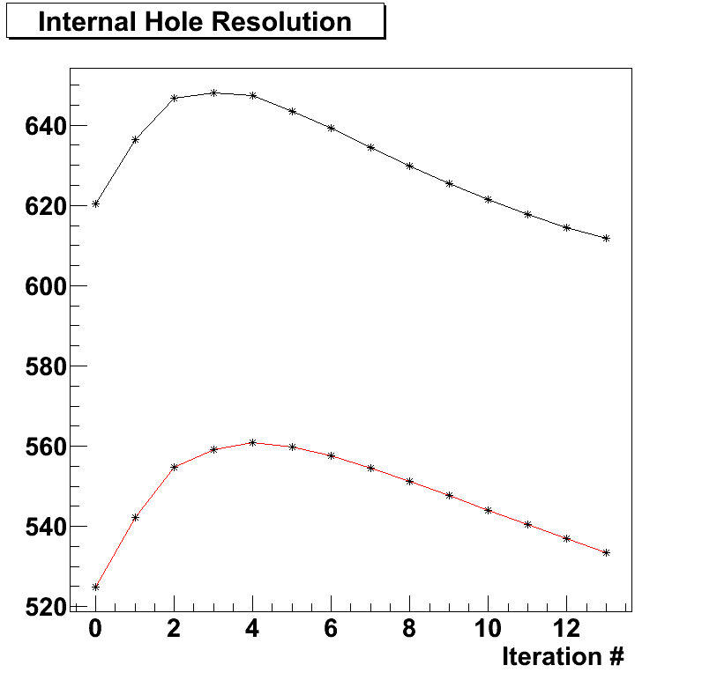
ART Resolutions
Small hole
Resolution [μm]
Two different edge
Positions
Large hole
Inner holes:
resolution affected by
multiple scattering
External edges

Slide 16

pCT upgrade (5x20cm²)
A system similar to the one already tested
  Microstrip tracker
  YAG:Ce calorimeter
But with a 50 x 200 mm² field of view
On-line data aquisition
1 MHz capability
Rectangular aspect ratio to perform tomographies in slices
Phantom
Beam pipe
Tracker planes
Silicon sensors
Calorimeter

Slide 17
Tracker plane configuration
2x4 silicon microstrip sensors glued onto a 40x45 cm² 12 layer PCB (components on both sides: front x-coordinate, rear y-coordinate)
  1 PCB per plane instead of 4 as in the previous prototype
6 read-out groups, 256 channels each
One Xilinx Spartan 6 per group for: sampling, event assembly, zero suppression and data transmission
One Spartan 6 for event building, data receiving and buffer, high speed link (8 serial links running at 200Mbs)
Silicon sensors overlapped to avoid blind area (see comments on MLP error envelope toward the end of this talk)
Up to 5 planes could be read-out by a Virtex6 acquisition board

Slide 18
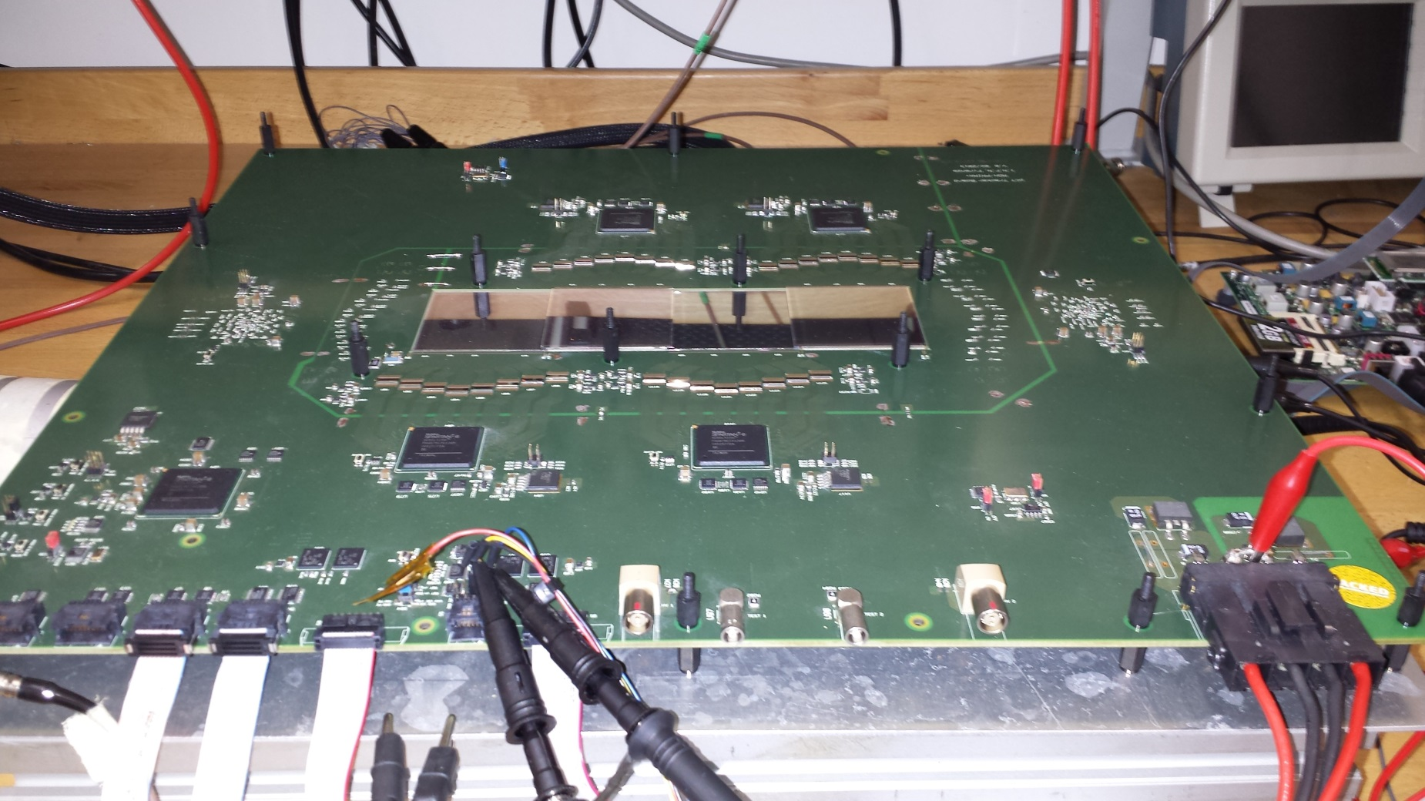
Fully assembled Tracker plane
Chip front-end
Silicon μstrip
Master FPGA
Virtex6
Slave FPGAs

Slide 19
Silicon microstrip detectors
36 p on n single-sided silicon microstrip detectors (HPK):
  51.2 x 51.2 mm² active area
  <100> crystal type
  320 μm thickness
  200 μm pitch
  256 channels
  I(Vfd)~2-3nA/cm²
Full Depletion Voltage (V)
No bad strips for all 36 detectors (9216 strips)

Slide 20
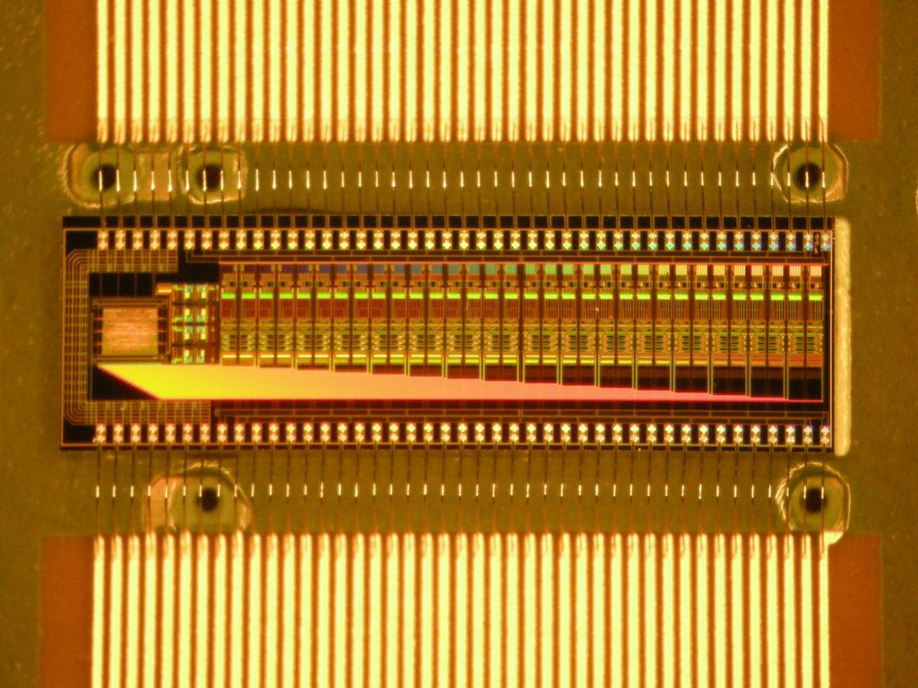
Front-end ASICs
32 channels parallel output discriminator (evolution of the previuos one)
Channel-by-channel 8-bit thresholds loaded via I²C
AMS–CMOS 0.35μm

Slide 21
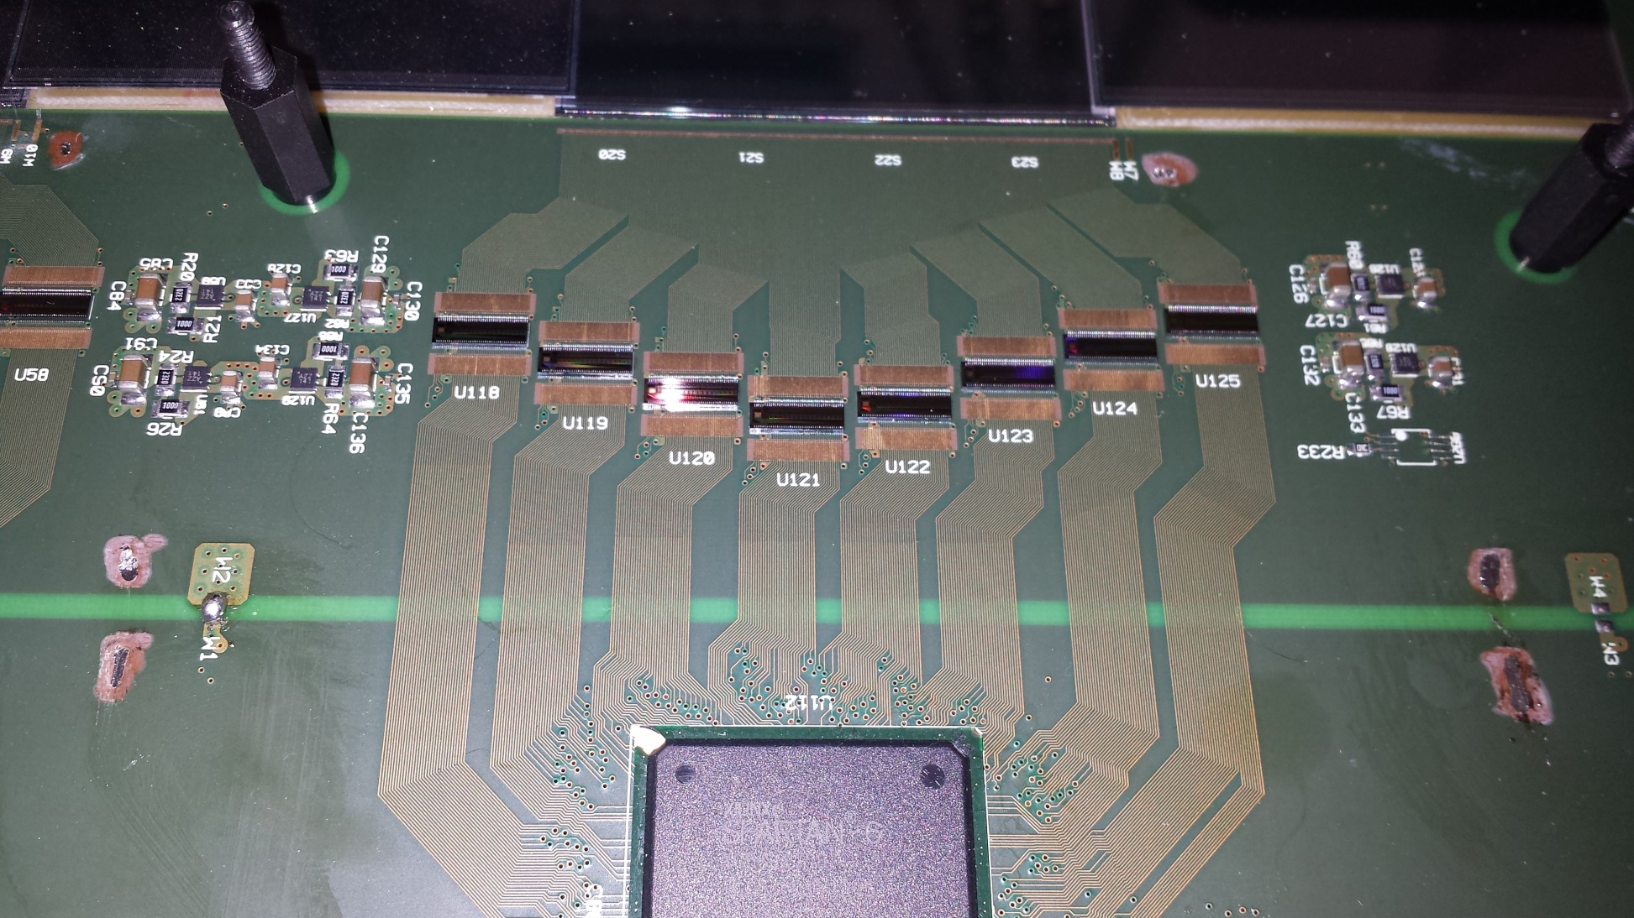
Read-out group
Silicon microstrip detectors
Front-end chips
Power regulators
FPGA slave

Slide 22
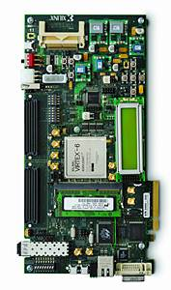
Tracker DAQ architecture
Calorimeter DAQ
SSD 1
SSD 1
Trigger
gen
Trigger
enable
SSD 1
256
Front end 1
256
SS 1
SSD 1
256
Front end 1
256
SS 1
7
256
Front end 1
256
SS 1
256
Front end 1
256
SS 1
.
.
.
SM
.
.
.
SM
4/5 readout links 1.6 Gbs each
.
.
.
SM
SSD 6
.
.
.
SM
SSD 6
SSD 6
256
Front end 6
256
SS 6
SSD 6
256
Front end 6
256
SS 6
256
Front end 6
256
SS 6
256
Front end 6
256
SS 6
Trigger
serial link data/clk
200 Mbs
serial link data/clk
200 Mbs
6 readout links
200(x8) Mbs each
gen
tracker plane
serial link data/clk
200 Mbs
7
2GB DDR3 RAM
tracker plane
tracker plane
Trigger enable
tracker plane
The front end of each detector will read-out by a Xilinx Spartan 6 FPGA (SS)
When a trigger occurs the read-out unit containing at least one hit will send the data to a central FPGA (SM)
The SM will asynchronously send the data to the central acquisition board
Central acquisition
Virtex 6
ML605 board
1Gbs Ethernet

Slide 23
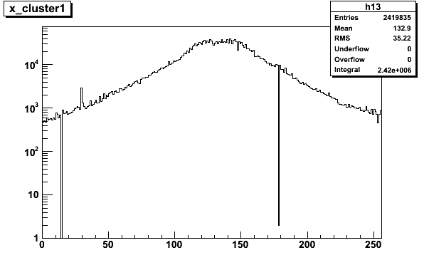
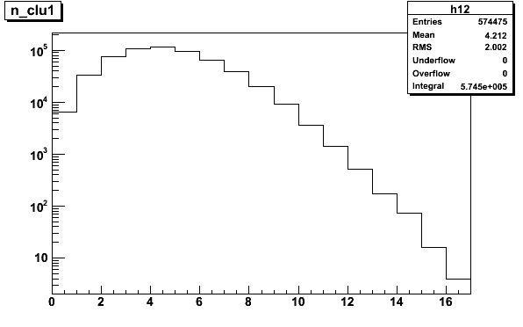
Test results with high intensity ⁹⁰Sr source
Number of clusters (electrons) per
event <N_{clu}>=4.2
2.5μs DAQ window → ~ 2 MHz of e⁻
Presently @350kHz max. trigger rate
# strip
Source profile
Two not working strips:
one because of sensor
one because of front-end chip
(one ~hot)
# cluster

Slide 24
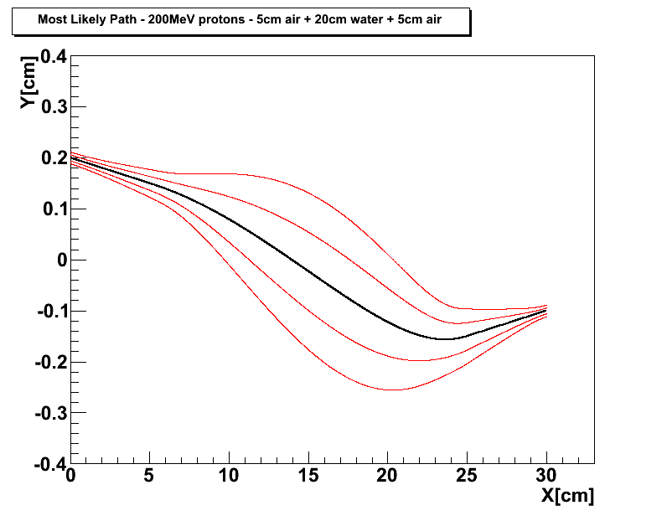
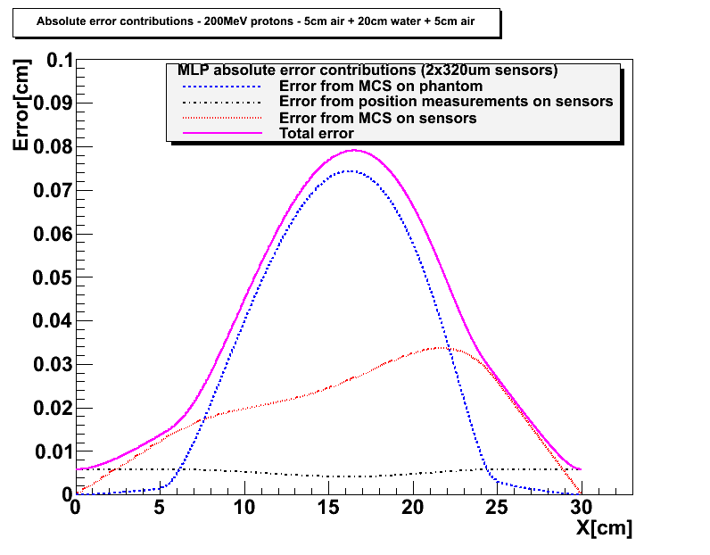
MLP in a realistic pCT geometry
Starting from D.C. Williams Phys. Med. Biol. 49 (2004) and R.W. Shulte at al. Med. Phys. 35 (11) (2008)
5 cm of air have been inserted in front and behind the 20cm H₂O phantom
MLP example with 200MeV
kinetic energy protons in
20cm of water:
Entry: Y(0) = 0.2cm
Y’(0) = -10mrad
Exit: Y(20) = -0.1cm
Y’(20) = +10mrad
Silicon microstrip detectors:
320μm thick
200μm strip pitch
MLP error envelope plus contributions from detector position measurement error (~ pitch/√12) and MCS inside the silicon sensors →
The sensor thickness contribution affects only the MLP error at the edge of the phantom
σ ~ 150-250μm
200MeV in
90MeV out

Slide 25
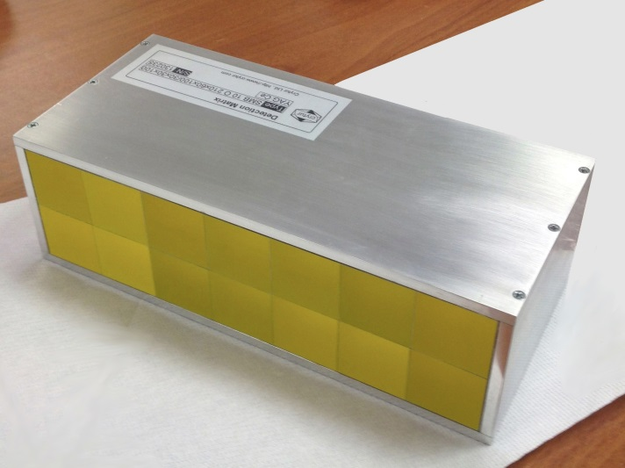
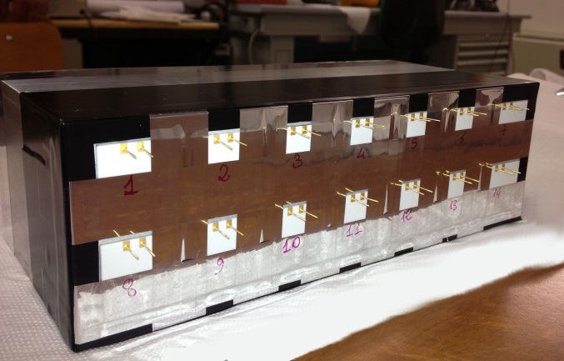
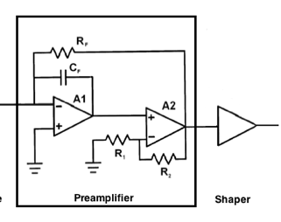
YAG:Ce calorimeter
Data Acquisition System
2x7 YAG:Ce Crystals Array
Size: 3x3x10cm³
FlexRIO
NI PXIe-7962R
CHASSIS NI PXIe-1071
Ad.Mod.
NI-5751
14 Analog Channels
Parallel read-out
Sampling: 5MS/s
24 Samples x event
RT Controller
NI PXI-8102
7Dig I/O GEN
Dig. Trigger
Disable Trigger
Silicon Photodiodes 1.8x1.8cm²
Tracker
x14
Fast Charge Amplifier + Shaper

Slide 26
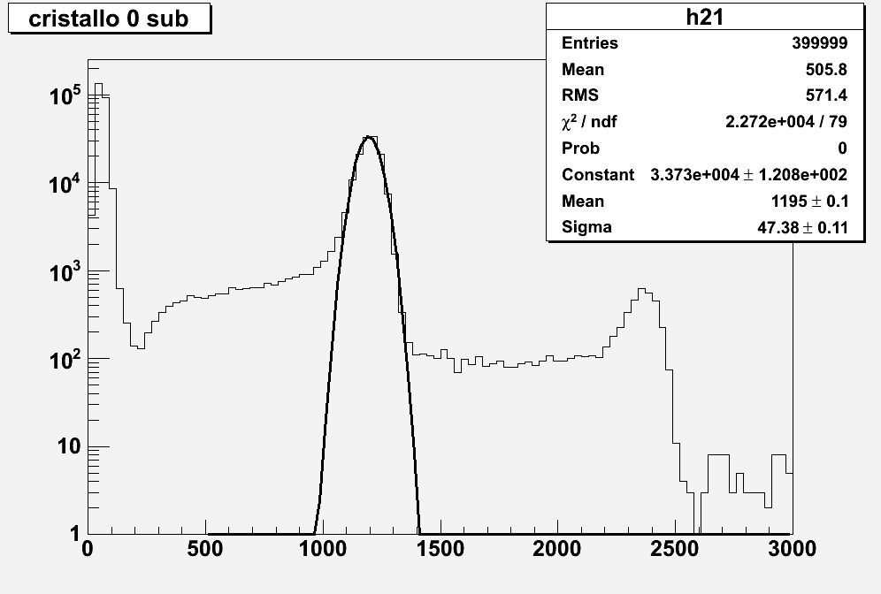
New YAG:Ce calorimeter data
60 MeV
σ=3.9%
Double protons=120 MeV
Noise = 10 MeV
ADC counts

Slide 27
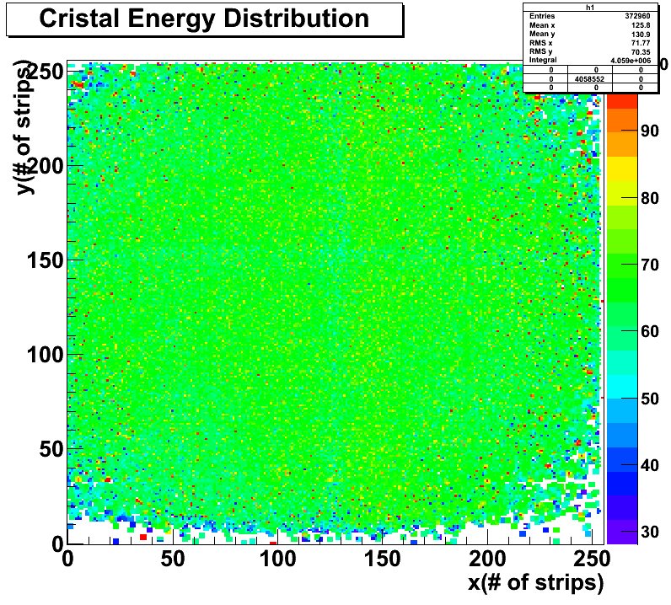
Energy distribution
Uniformity od the calorimeter energy distribution as function of the track impact point as measured by the tracker
E=60MeV
Preliminary crystal calibration
Preliminary

Slide 28
Medium term plan
Small area system
  Implement MLP into ART (+3D reconstruction)
  Analize Svedberg Laboratory run (Uppsala) at 180 MeV data
  Analize INFN-LNS run (Catania) at 60 MeV with multi-material phantom
  A second run at Uppsala is foreseen this summer
Extended view system
  Validate the tracker plane hardware at 60 MeV
  Production of the 4/5 final tracker planes
  Integration with the calorimeter read-out

